Slide 1

Principles of Program Design: Problem Solving with JavaScript
Chapter 5
The Selection Structure

Slide 2
Objectives
In this chapter, you learn to:
Define a Boolean expression
Explain why a condition can have only two outcomes
Define a selection structure
Describe common relational operators and their functions
Differentiate between a single-outcome and dual-outcome selection

Slide 3
Objectives (cont’d.)
Describe the scope of a selection structure and how it’s specified in pseudocode, flowcharts, and JavaScript
Define a nested structure
Design algorithms that evaluate several values for a variable
Define and use the Case structure

Slide 4
Introduction
Selection structure
  Evaluates a condition
    Expression that is true or false
  Choose between alternate courses of action
  One course of action might be to do nothing

Slide 5
Conditions: Boolean Expressions
Condition
  Describes relationship between two values
  Uses relational operators
Boolean expression
  Evaluates to either true or false

Slide 6
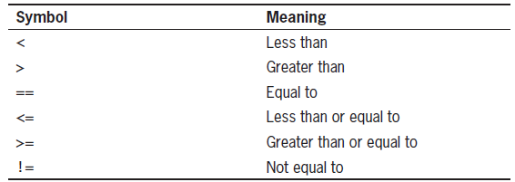
Conditions: Boolean Expressions (cont’d.)
Table 5-1 Relational operators

Slide 7
Conditions: Boolean Expressions (cont’d.)
Compare two variables
  Or a variable and a constant
Double equals sign
  Tests whether two values are equal
  Unlike single equals sign, used in assignment statements

Slide 8
Conditions: Boolean Expressions (cont’d.)
Comparing values with If: the single-outcome selection
  Simplest selection structure
  Action is taken if condition evaluates to true
  No action taken if condition evaluates to false
Three parts of single-outcome selection
  The word If, the condition expression, and the word Then
  The statement performed if condition is true
  The words End If lined up under the word If

Slide 9
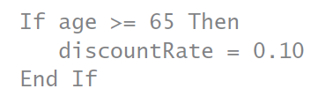
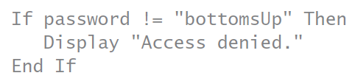
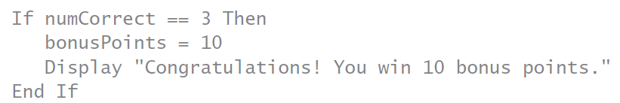
Conditions: Boolean Expressions (cont’d.)
Single-outcome selection examples:

Slide 10
Conditions: Boolean Expressions (cont’d.)
Flowchart for selection structures
  Diamond symbol used for condition expression
  Question mark at end of expression
  Two exits, or branches
    Marked true and false, or yes and no
  Flowlines on true side connect to actions taken if condition is true
  No action is taken on the false branch
  Round connector symbol represents End If statement

Slide 11
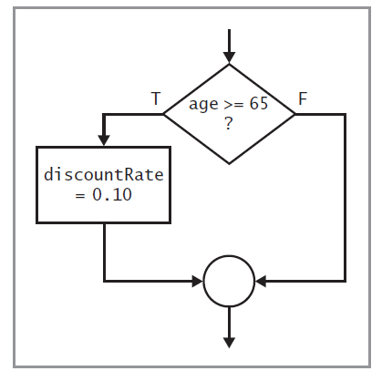
Conditions: Boolean Expressions (cont’d.)
Figure 5-1 A flowchart segment for a single-outcome selection that tests the value of someone’s age

Slide 12
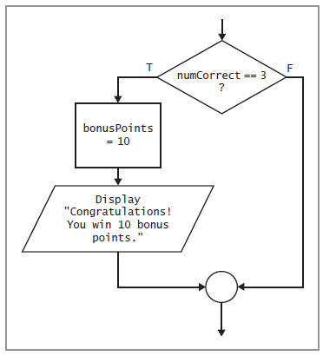
Conditions: Boolean Expressions (cont’d.)
Figure 5-3 A flowchart segment for a single-outcome selection that tests the value of the number of correct items

Slide 13
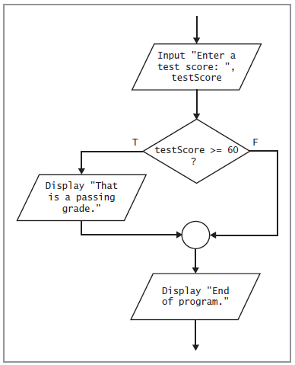
Conditions: Boolean Expressions (cont’d.)
Figure 5-4 A flowchart segment for a selection in a sequence

Slide 14
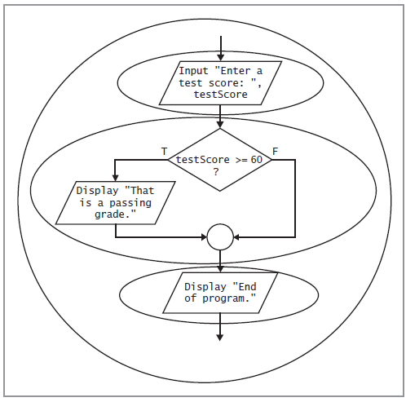
Conditions: Boolean Expressions (cont’d.)
Structures can contain other structures
Structures may not overlap
Figure 5-6 A flowchart example with the structures circled

Slide 15
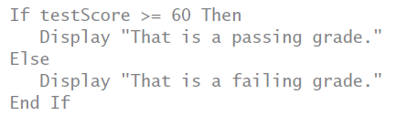
Conditions: Boolean Expressions (cont’d.)
Comparing values with If and Else: the dual-outcome selection
  Perform one set of steps if the condition is true
  Perform different set of steps if the condition is false
Example:

Slide 16
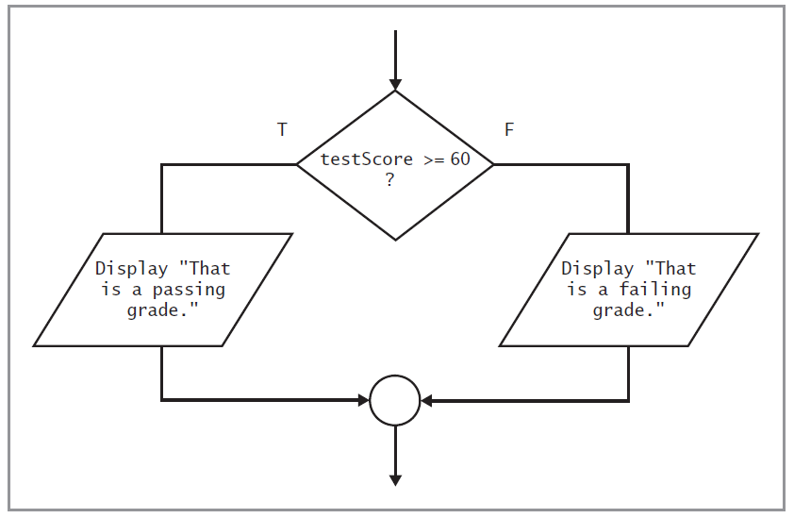
Conditions: Boolean Expressions (cont’d.)
Figure 5-7 A flowchart for a dual-outcome selection

Slide 17
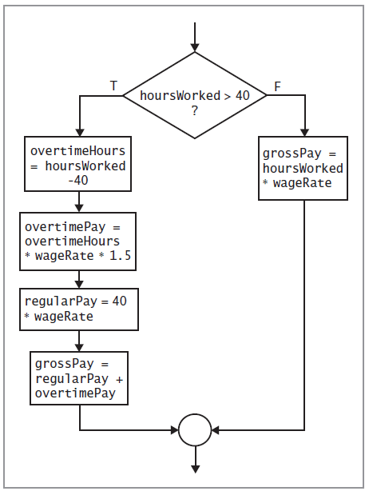
Figure 5-8 A flowchart for a dual-outcome selection with multiple actions

Slide 18
The Selection Structure in JavaScript
Selection structure syntax in JavaScript
  The if and else keywords are lowercase
  The then keyword isn’t used
  Conditions are placed inside parentheses
  Braces are used to define scope of true and false branches

Slide 19
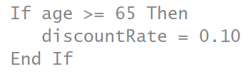
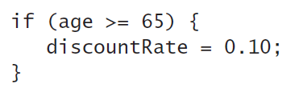
The Selection Structure in JavaScript (cont’d.)
Example: single-outcome selection in pseudocode and JavaScript:

Slide 20
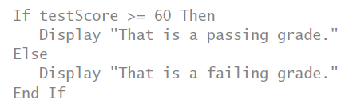
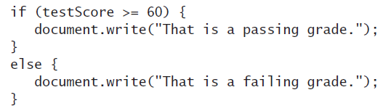
The Selection Structure in JavaScript (cont’d.)
Semicolon used after assignment statement
  But not after a condition
Example: dual-outcome selection in pseudocode and JavaScript:

Slide 21
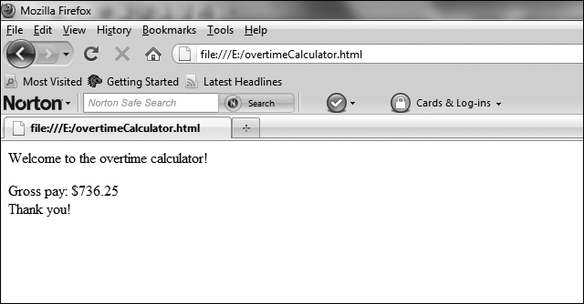
The Selection Structure in JavaScript (cont’d.)
Complete Program 5-1 on pages 176-177
  Then convert to JavaScript
Figure 5-9 The overtimeCalculator.html program in a Web browser

Slide 22
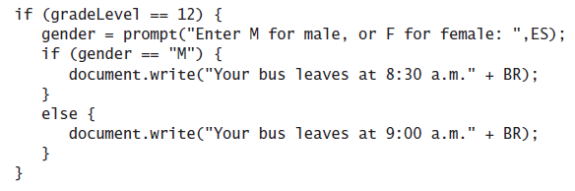
The Selection Structure in JavaScript (cont’d.)
Nested selection
  Selection contained within the scope of another selection
Example: Grade 12 boys’ and girls’ field trip buses leaving at different times

Slide 23
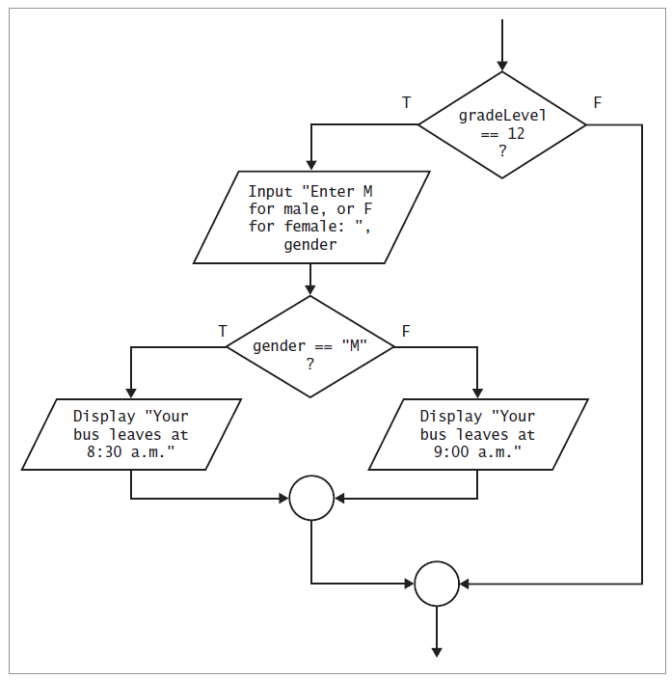
Figure 5-10 The flowchart for determining bus times by gender and grade level

Slide 24
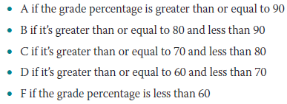
The Selection Structure in JavaScript (cont’d.)
May have several different conditions to test for a variable
  Example: grading scale
  Can create with several selection statements
  Testing each condition separately is inefficient

Slide 25
The Selection Structure in JavaScript (cont’d.)
Grading scale solution using nested selections
  Test to determine whether score is 90 or more
  If not, test to determine whether score is between 80 and 90
    If yes, assign grade B
    If no, test for score between 70 and 80
    If yes, assign grade C
    If no, test for score between 60 and 70
    If yes, assign D
    If no, assign F

Slide 26
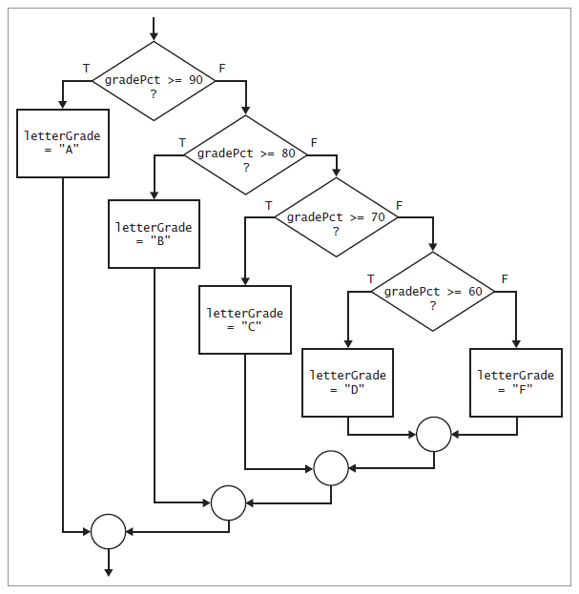
Figure 5-11 The flowchart for assigning letter grades

Slide 27
The Selection Structure in JavaScript (cont’d.)
Streamlining nested selections: Else If and the Case structure
  Solution to using many levels of indentation
  No closing End If required for each nested structure
  End If only required for outermost structure

Slide 28
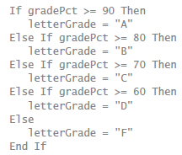
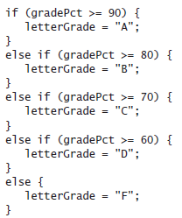
The Selection Structure in JavaScript (cont’d.)
Grading example in pseudocode and JavaScript:

Slide 29
The Selection Structure in JavaScript (cont’d.)
Case structure
  Variation of the selection structure
  Begins with pseudocode keyword Select:
    Followed by variable name and a colon
  Test conditions include the keyword Case:
    Followed by the value to test against and a colon
  Last Case statement is the Default case

Slide 30
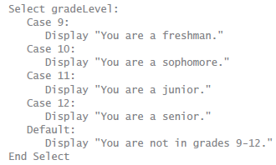
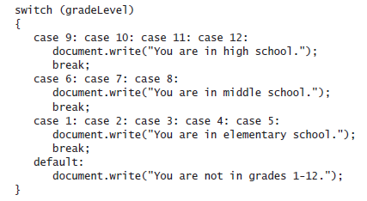
The Selection Structure in JavaScript (cont’d.)
Example: determine student grade level

Slide 31
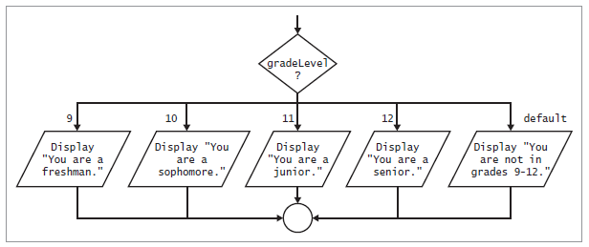
The Selection Structure in JavaScript (cont’d.)
Figure 5-12 A flowchart for a Case structure

Slide 32
The Selection Structure in JavaScript (cont’d.)
Case structure (cont’d.)
  In JavaScript and other languages:
    Can test only for equality of values
    Not inequalities using number ranges
  Limited to integers and text characters
    No decimal numbers
Keyword switch used in JavaScript
break command exits the Case structure

Slide 33
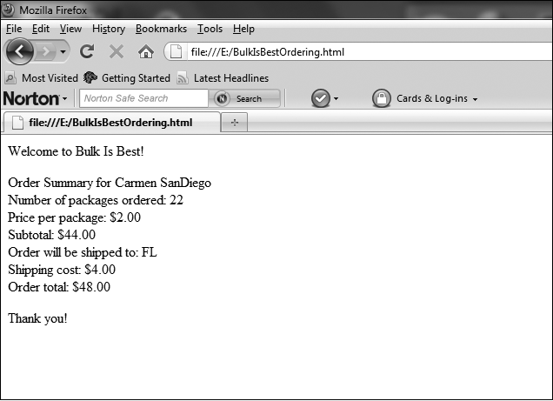
The Selection Structure in JavaScript (cont’d.)
Complete Programmer’s Workshop on pages 186-188
  Then convert to JavaScript
Figure 5-13 The bulkIsBestOrdering.html program in a Web browser

Slide 34
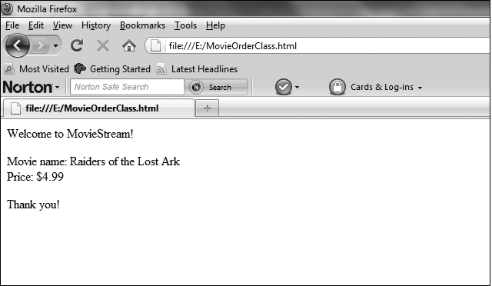
The Selection Structure in JavaScript (cont’d.)
Complete Object Lesson on pages 189-192
  Then convert to JavaScript
Figure 5-15 The MovieOrderClass.html file in a Web browser

Slide 35
Summary
A condition compares two values
  Uses one of six relational operators
Boolean expression
  Condition that evaluates as true or false
Selection structure parts
  Boolean expression
  Statements to be performed if evaluated as true
  Optional statements to be performed if false
Branches: true and false exits from a condition

Slide 36
Summary (cont’d.)
Single-outcome selection
  Performs one action if condition is true
Dual-outcome selection
  Performs one action if condition is true
  And a different action if condition is false
Selections may be nested
Else If and Case statements can replace nested selections
  Makes code more efficient

